Slide 1
Finding Reliable Resources on the Web
Ms. Groat

Slide 2
TRAAP test for Reliable Sources
Timeliness – the “newness” of the information
--Have there been new versions or editions since this was published?
Relevance – the depth and importance of the information
--How detailed is the information? Is it too basic for your needs? Too advanced?
Authority – the source of the information
--Was it self-published or posted on a personal site?
Accuracy – the reliability and correctness of the information
--Where does the information come from?
Purpose – the reason the information was created
--Is the author looking to inform, teach, advocate, sell, or entertain?

Slide 3
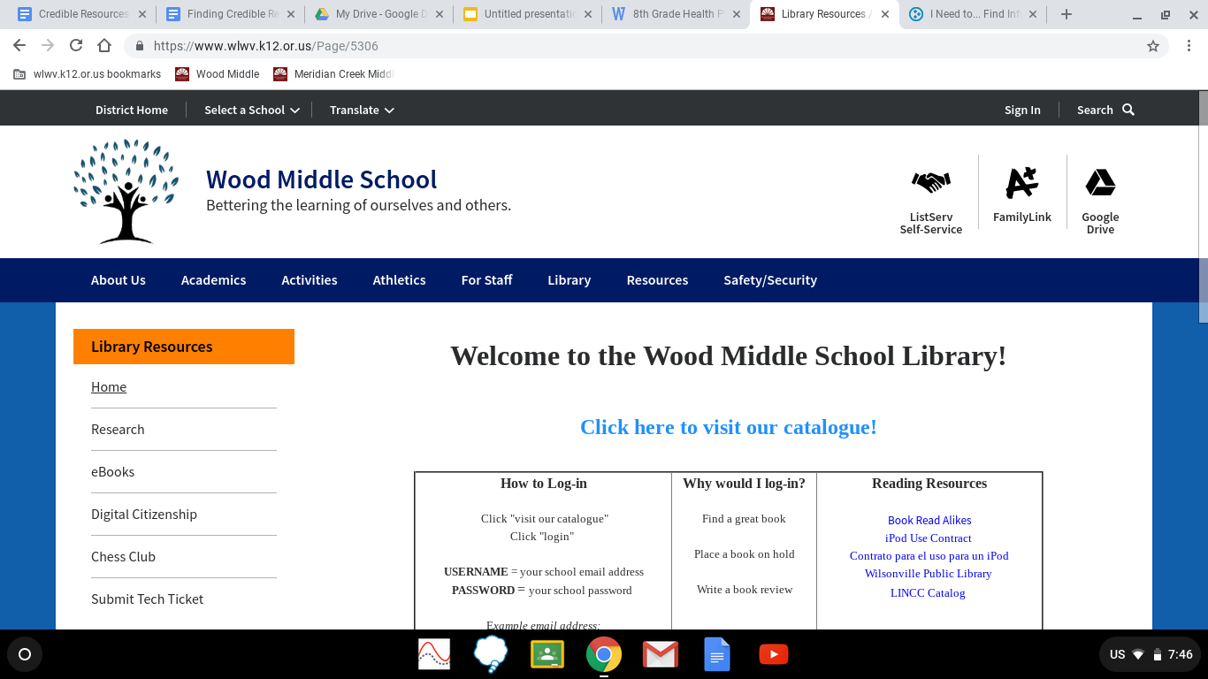
All sources on OSLIS/Gale passes TRAAP
Step 1: Click on “Library,” then click on “Research”

Slide 4
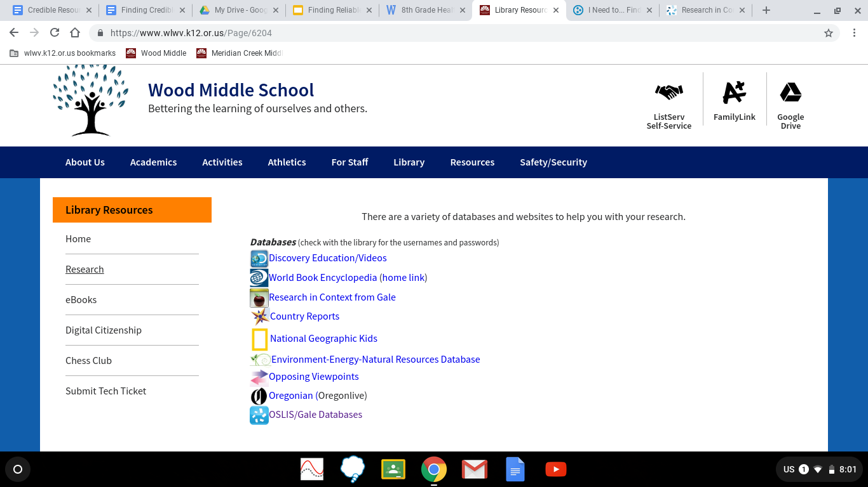
Step 2: Click on “OSLIS/Gale Databases”

Slide 5
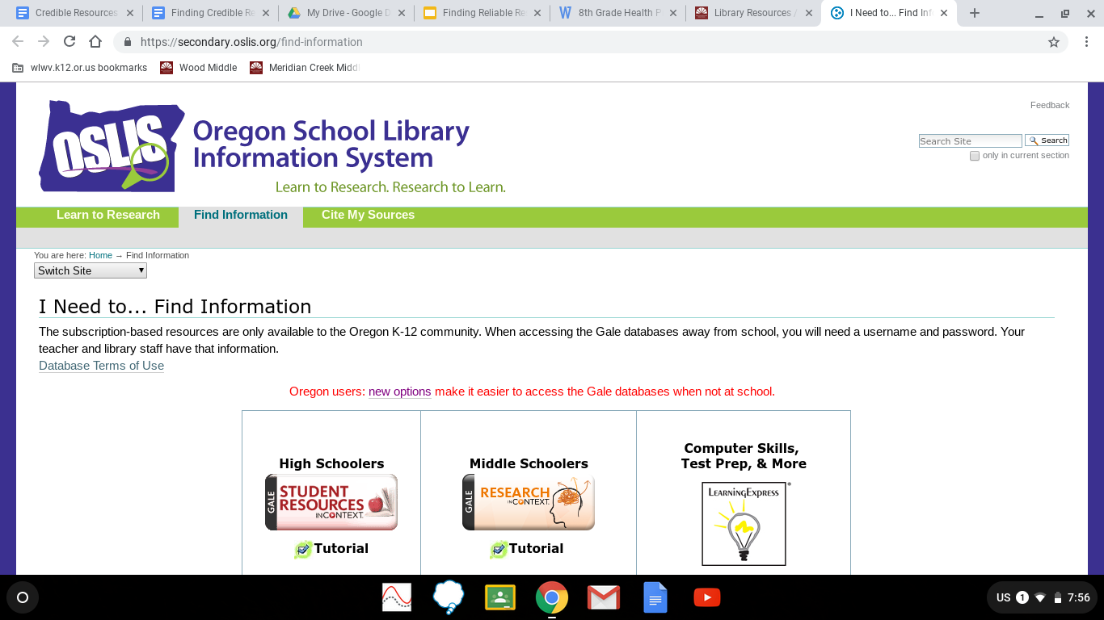
Step 3: Click on “Middle Schoolers”

Slide 6
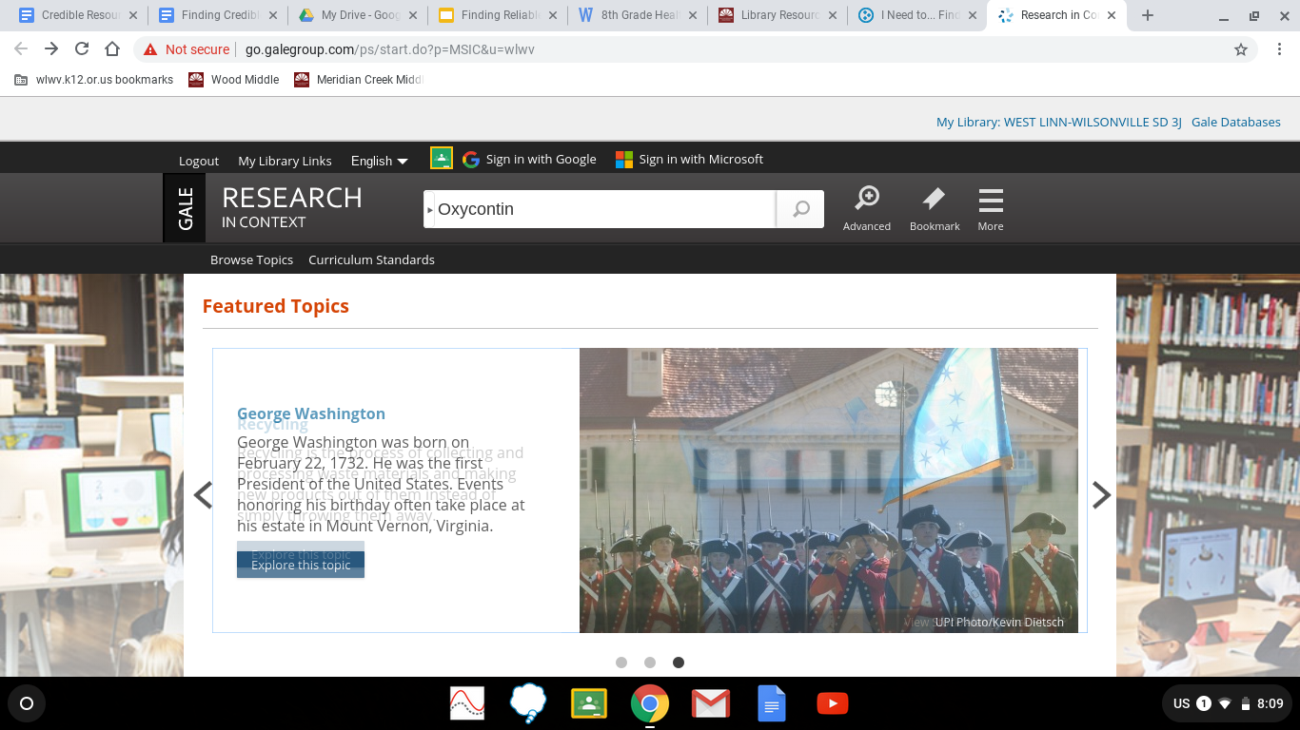
Step 4: Begin your research
Tips for searching:
-No questions
-Use “and” to focus search
-Use “- ___” to cut out unnecessary information
EX: Heroin - celebrities

Slide 7
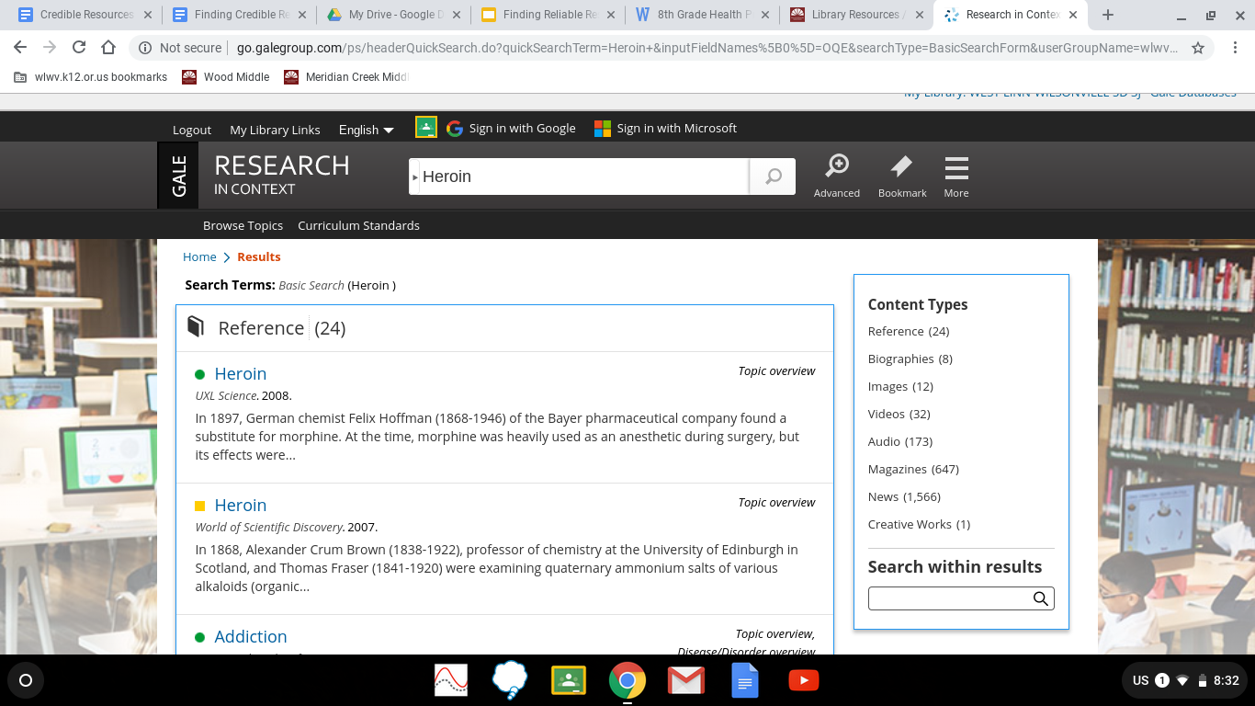
Gale Hack #1: Assess your results
If you have too many results, use “and _____” to help focus results.

Slide 8
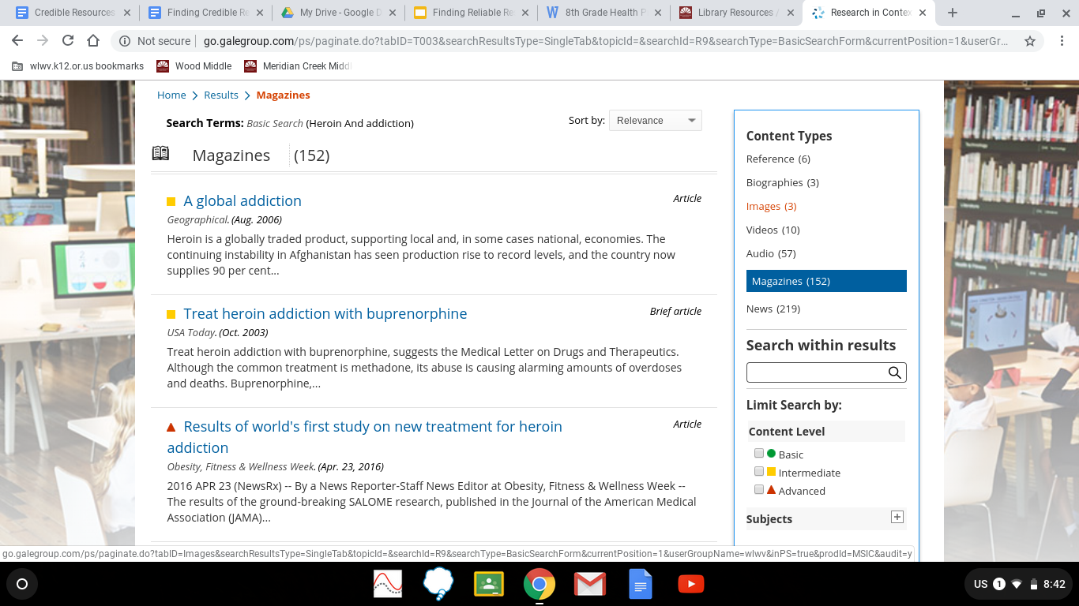
Gale Hack #2: Focus the “Content Level” to your reading level
You can focus search on reading level in “Content Level.”
Green = Middle school level
Yellow = High school level
Red = College level

Slide 9
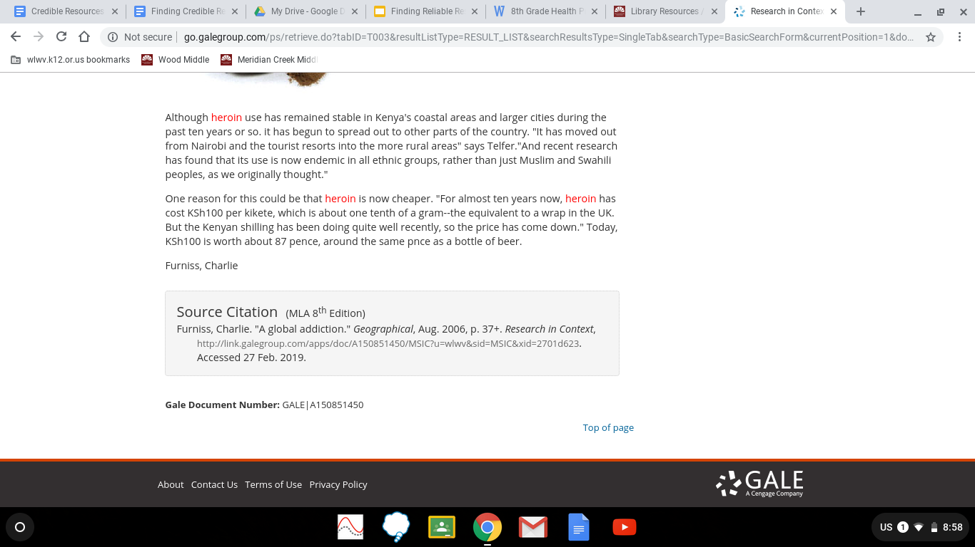
Gale Hack #3: Source Citations are found at the bottom of each article
Copy citation and paste onto your Work Cited page
Once you have all your citations, check that the font, size, and color is all the same.

